Slide 1


Work in pairs. Look at the photo and the caption. Choose the phrase you think best describes the photo.
a faithful companion blood relatives
a passing acquaintance mutual respect a strong bond true friends an odd couple
Look at these English sayings about relationships. What do they mean? Do you have a similar saying in your language?
Blood is thicker than water
A friend in need is a friend indeed
Like father, like son
No man is an island

Slide 2
Vocabulary Notes
‘Blood is thicker than water’ = family relationships and
loyalties are the strongest and most important ones
‘A friend in need is a friend indeed’ = a friend who
helps you when you really need help is a true friend
‘Like father, like son’ = you can expect a son’s
personality or behavior to be similar to that of
his father
‘No man is an island’ = nobody is self-sufficient –
people need the company and support of other
people (this is a quote from a poem by the sixteenth century English poet John Donne)

Slide 3
Vocabulary notes
a faithful companion = a companion is someone you
spend time with, perhaps on a journey, and ‘faithful’ means
that this is a friend who will always be there to help and
support you
blood relatives = people who are related by ‘blood’ (i.e.
genetically), e.g. your father or daughter, but not your
wife or mother-in-law
a passing acquaintance = an acquaintance is someone
you know, but not very well – ‘passing’, here, means for
a short time (e.g. someone you meet on holiday or on a
journey)
mutual respect = when two people feel similar admiration
for each other and treat each other politely and kindly
a strong bond = a very close relationship
true friends = friends who will always be together and will
always support each other
an odd couple = two people you don’t expect to be
together, perhaps because they look very different or have
very different personalities or interests

Slide 4
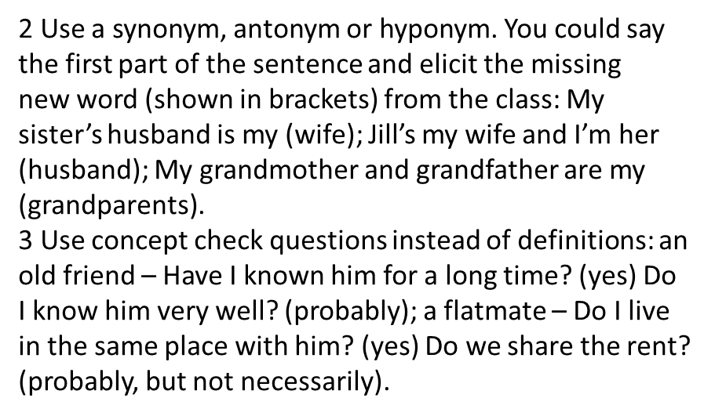
Checking new words
Instead of asking using dictionaries or translation
when checking the meaning of new words, use some of
the following techniques:
1 Put the new word in a sentence to provide context:
My fiancé and I have been engaged for six months and
we’re getting married in November. / Joe is a colleague
at work – we are in the same department, but he’s not a
friend.

Slide 5
Extra Activity
Talk about important relationships in your life . For example with:
a husband a fiancé
a colleague an old friend
a brother a grandparent
Think of a person a) you have been meaning to contact for ages; and b) you have shared a travel experience with. Tell your partner about these people.

